Slide 1
%%%%%%%%%%%%%%%%%%%%%%%%%%%%%%%%%%%%%%%%%%%%%%%%%%%%%%%%%%%%%%%%%%%%%
%% The "tocentry" environment can be used to create an entry for the
%% graphical table of contents. It is given here as some journals
%% require that it is printed as part of the abstract page. It will
%% be automatically moved as appropriate.
%%%%%%%%%%%%%%%%%%%%%%%%%%%%%%%%%%%%%%%%%%%%%%%%%%%%%%%%%%%%%%%%%%%%%
\begin{tocentry}
Some journals require a graphical entry for the Table of Contents.
This should be laid out ``print ready'' so that the sizing of the
text is correct.
Inside the \texttt{tocentry} environment, the font used is Helvetica
8\,pt, as required by \emph{Journal of the American Chemical
Society}.
The surrounding frame is 9\,cm by 3.5\,cm, which is the maximum
permitted for \emph{Journal of the American Chemical Society}
graphical table of content entries. The box will not resize if the
content is too big: instead it will overflow the edge of the box.
This box and the associated title will always be printed on a
separate page at the end of the document.
\end{tocentry}
9 cm * 3.5 cm

Slide 2
9:3.5

Slide 3
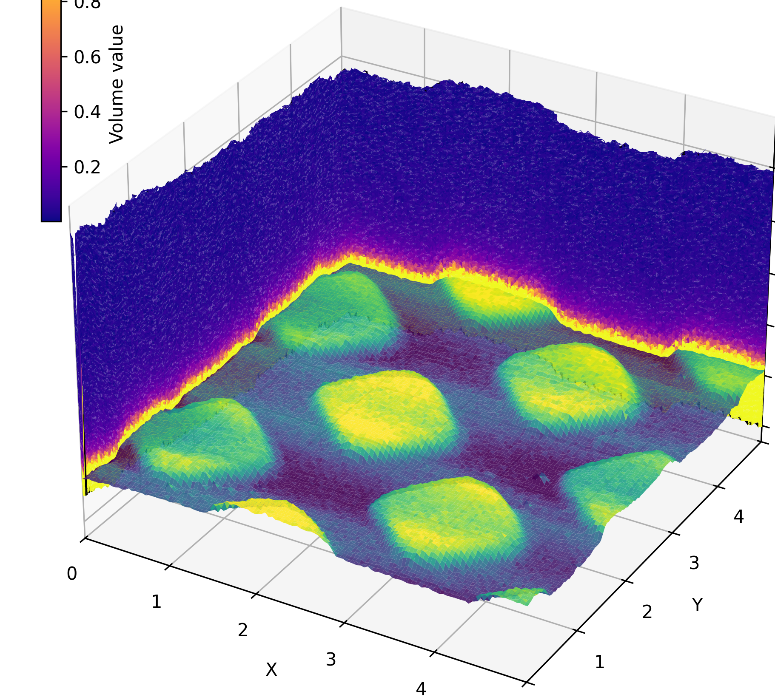
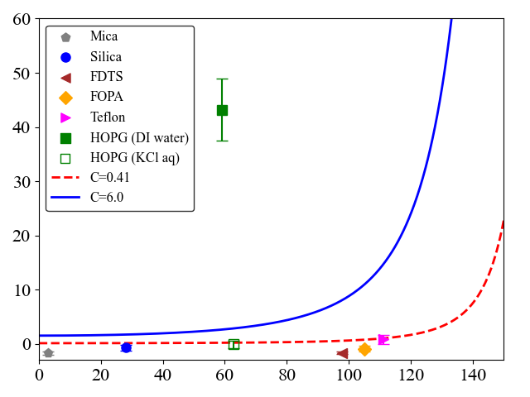
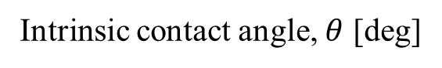
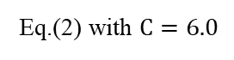
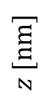
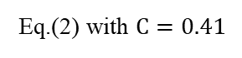
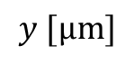
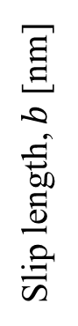
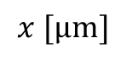
9:3.5
Mica
100
Silica
FDTS
80
FOPA
Teflon
Damping
40
HOPG (DI water)
20
HOPG (KCl aq.)
$$z [nm]$$
Slip length, $b$ [nm]
Eq.(2) with $C=6.0$
Decrease
in electrolytes
0
Eq.(2) with $C=0.41$
Unfeasible
5
4
3
Experimental
MD
5
Topography
4
2
$$y [μm]$$
3
2
1
Intrinsic contact angle, $θ$ [deg]
$$x [μm]$$
1
0
0

Slide 4


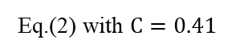
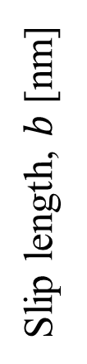
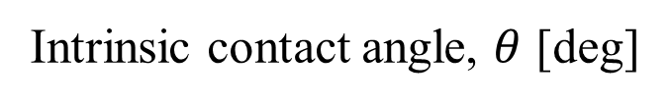
a
Damping
Mica
Silica
FDTS
FOPA
Teflon
Damping
HOPG (DI water)
Slip length, $b$ [nm]
HOPG (KCl aq.)
Eq.(2) with $C=6.0$
Decrease
in electrolytes
Eq.(2) with $C=0.41$
Unfeasible
Topography
Experimental
MD
Intrinsic contact angle, $θ$ [deg]

Slide 5
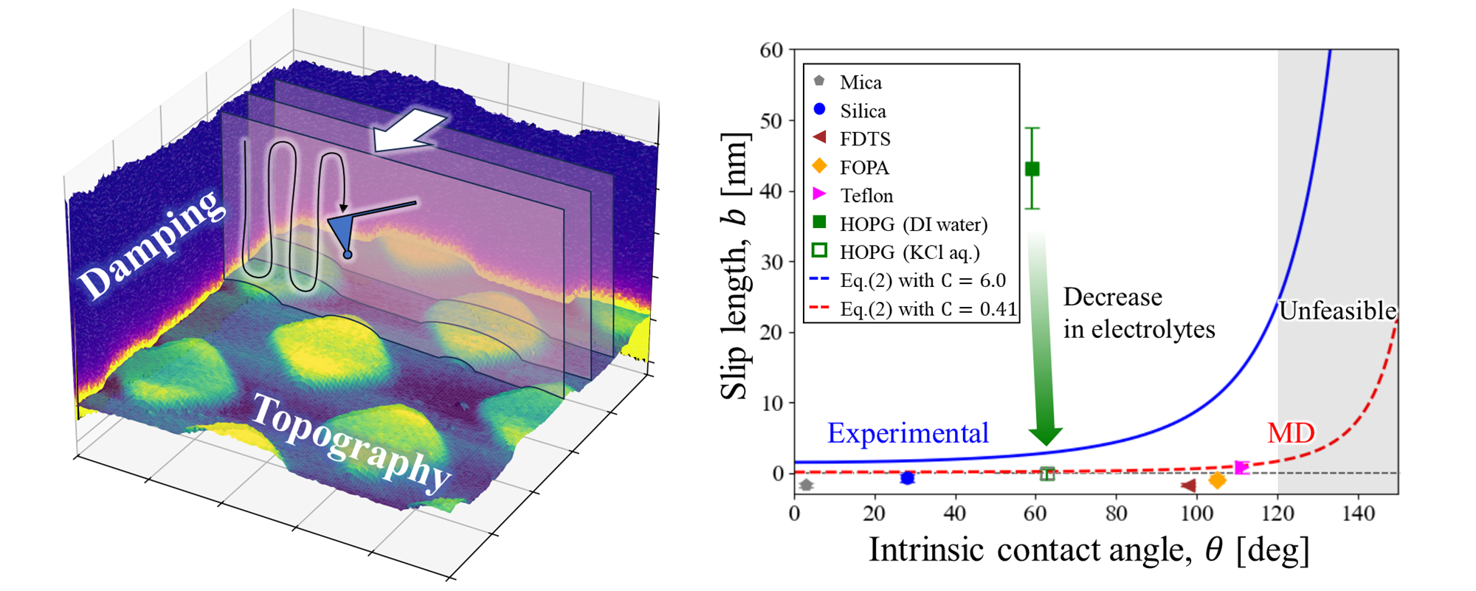

9 cm * 3.5 cm

Slide 6
Mica
100
Silica
1 μNs/m
FDTS
80
FOPA
Teflon
Damping
40
HOPG (DI water)
20
HOPG (KCl aq.)
$$z [nm]$$
Slip length, $b$ [nm]
Eq.(2) with $C=6.0$
Decrease
in electrolytes
0
Eq.(2) with $C=0.41$
Unfeasible
5
0 μNs/m
4
3
Experimental
MD
5
Topography
4
2
$$y [μm]$$
3
2
1
Intrinsic contact angle, $θ$ [deg]
$$x [μm]$$
1
0
0

Slide 7
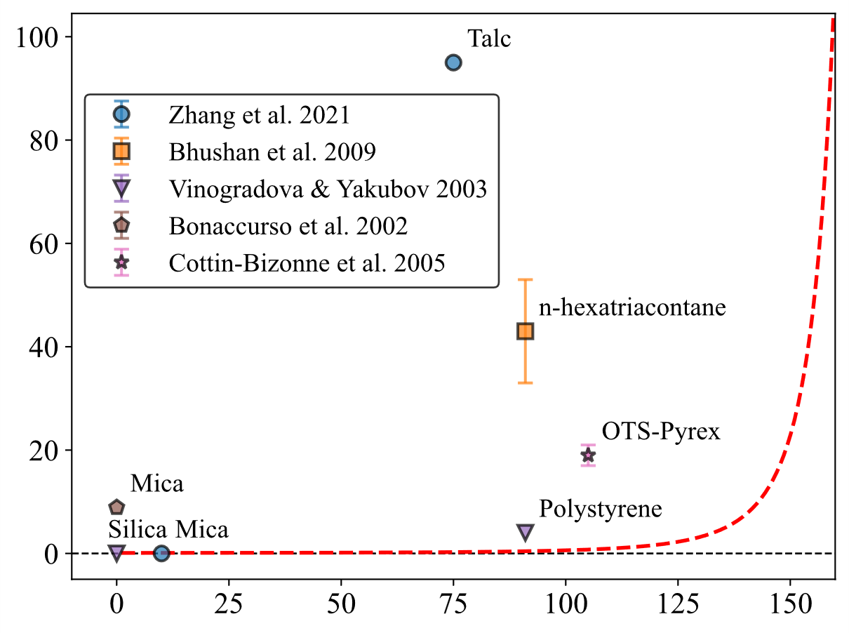
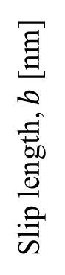
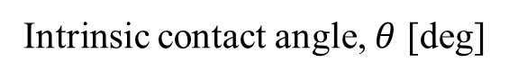
Slip length, $b$ [nm]
Intrinsic contact angle, $θ$ [deg]

Slide 8
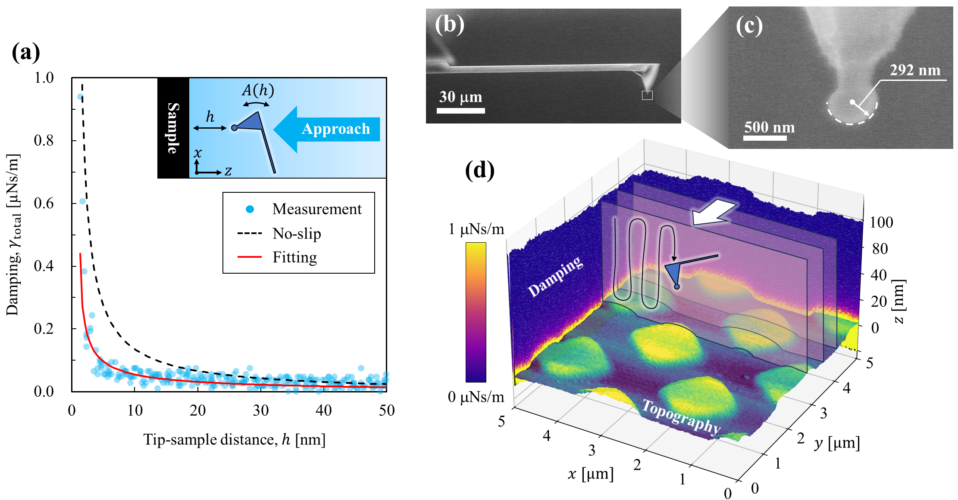

Slide 9
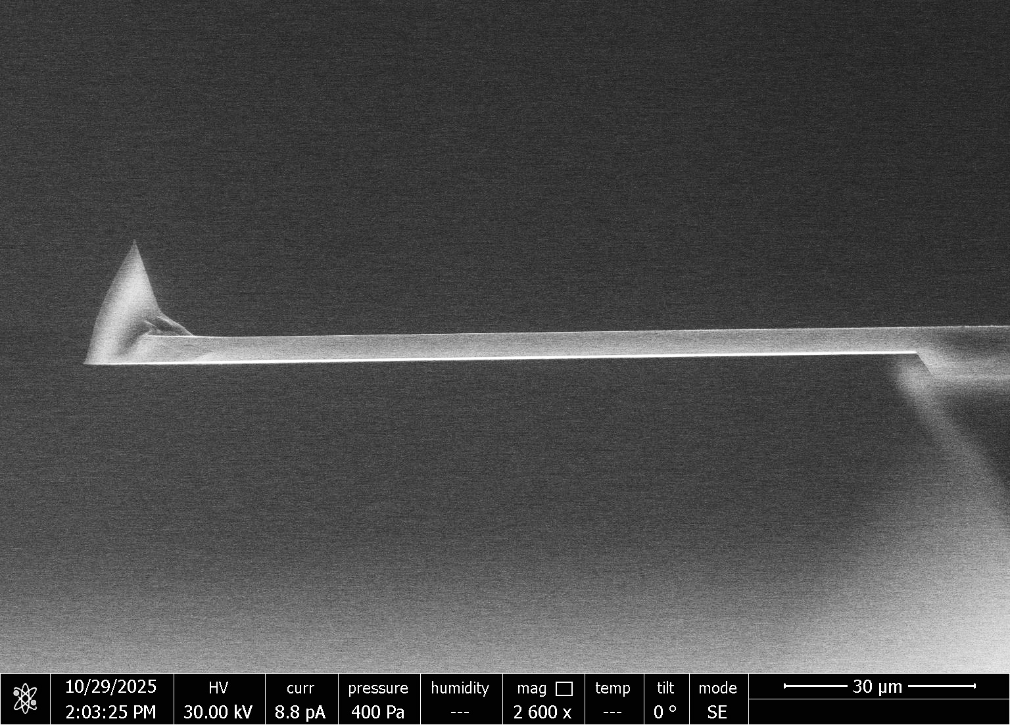
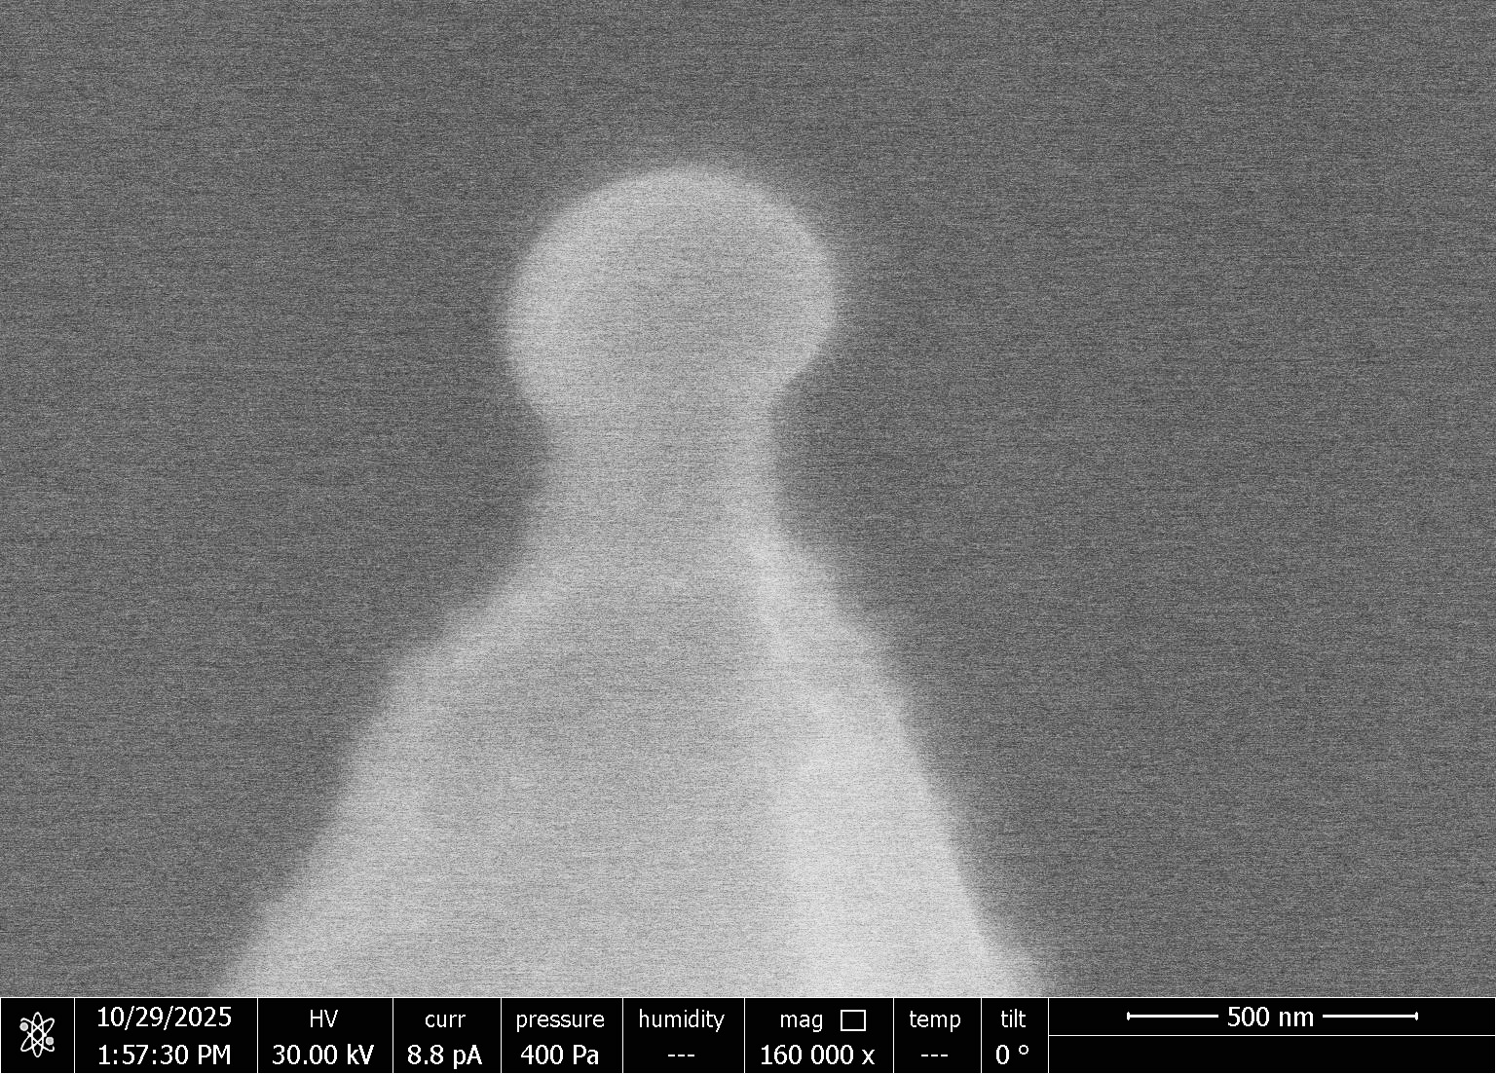
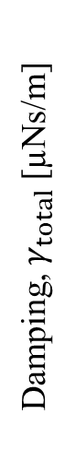
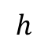
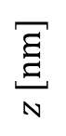
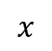
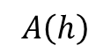
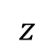
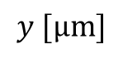
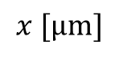
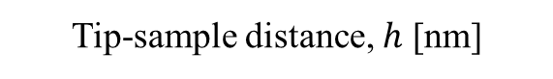
(b)
(c)
(a)
292 nm
$A\left(h\right)$
30 μm
$$h$$
Sample
Approach
500 nm
$$x$$
$$z$$
(d)
Measurement
Damping, $γ_{total}$ [µNs/m]
1 μNs/m
100
No-slip
Fitting
80
Damping
40
20
$$z [nm]$$
0
5
0 μNs/m
4
5
Topography
3
Tip-sample distance, $h$ [nm]
4
2
$$y [μm]$$
3
2
1
$$x [μm]$$
1
0
0

Slide 10
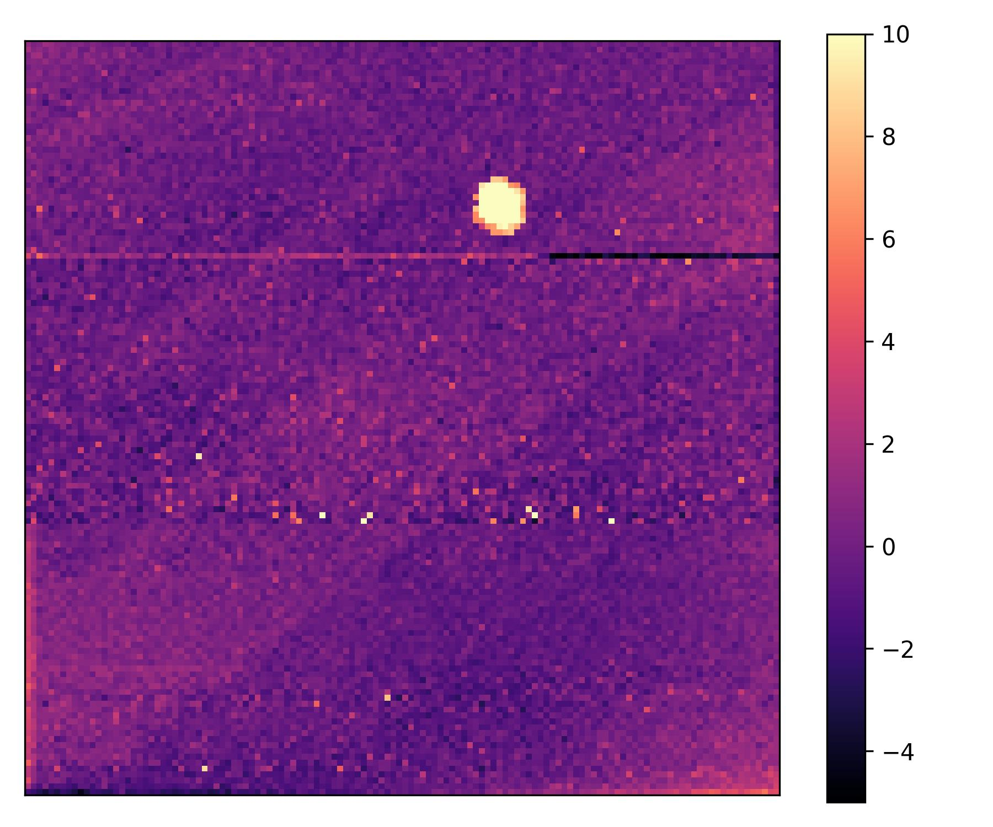
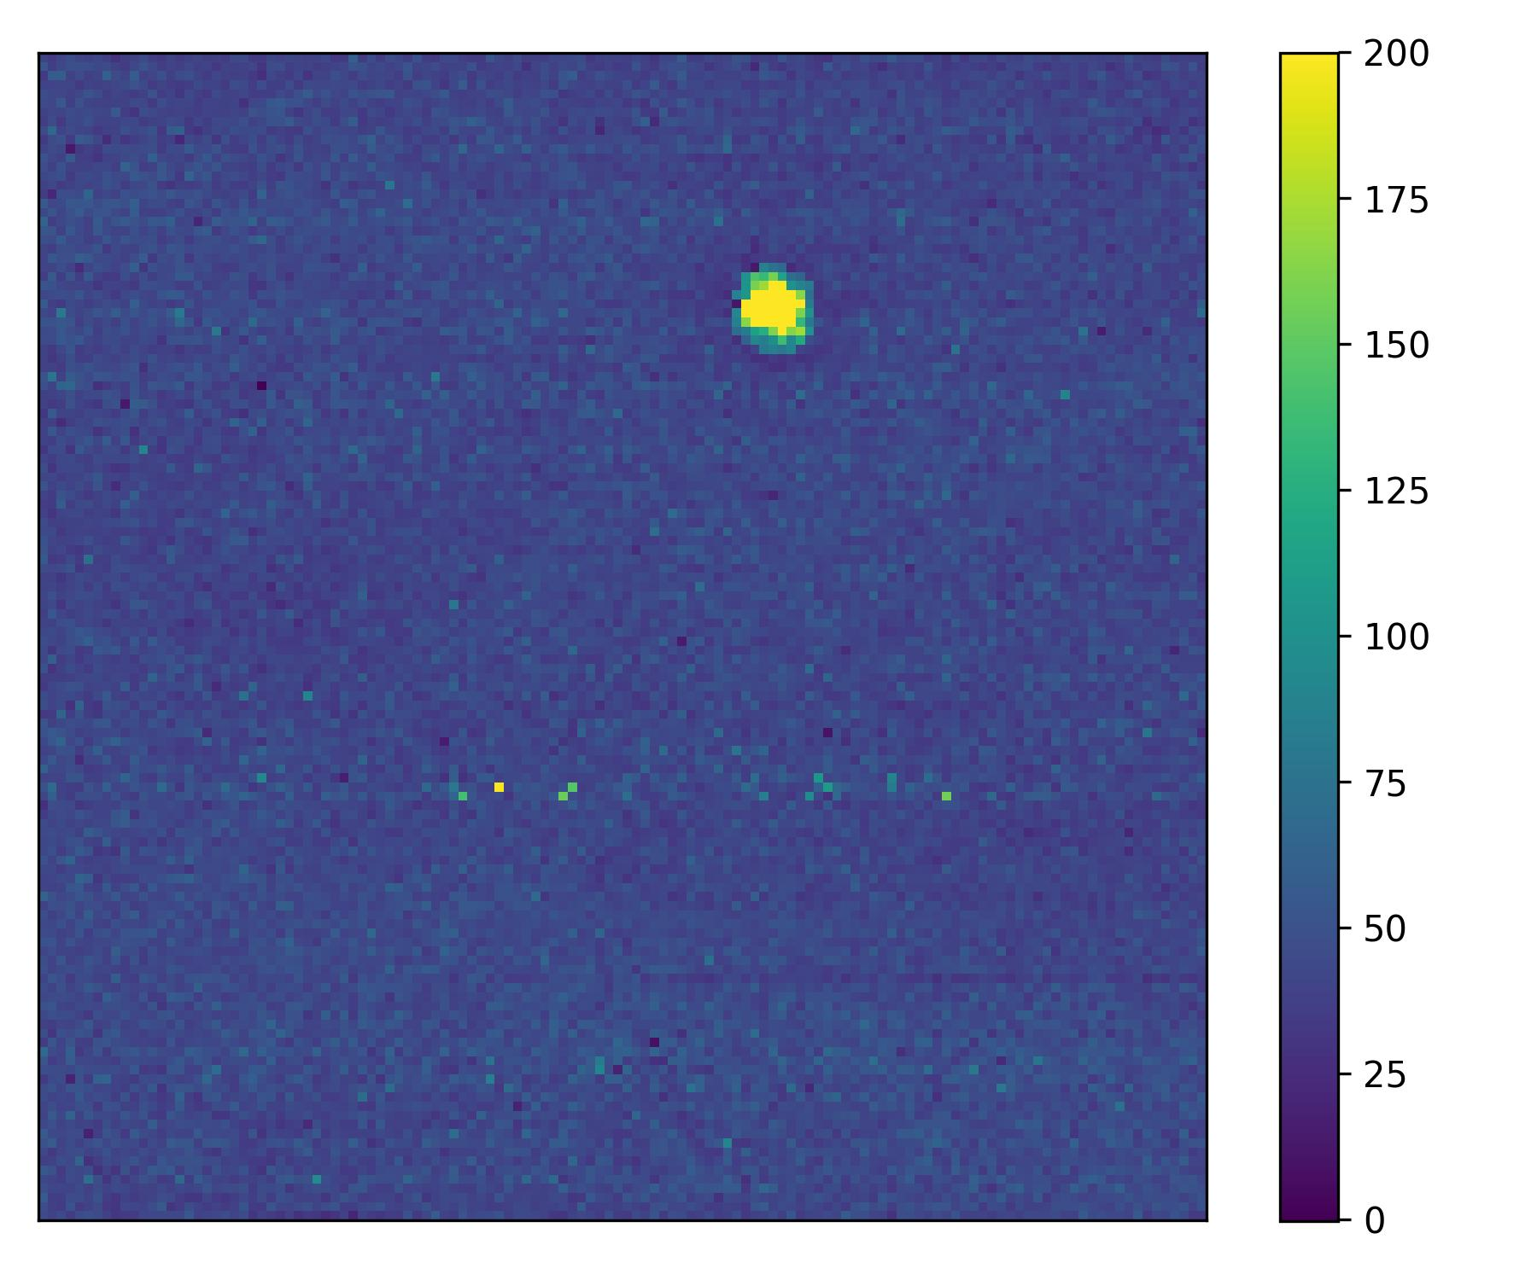
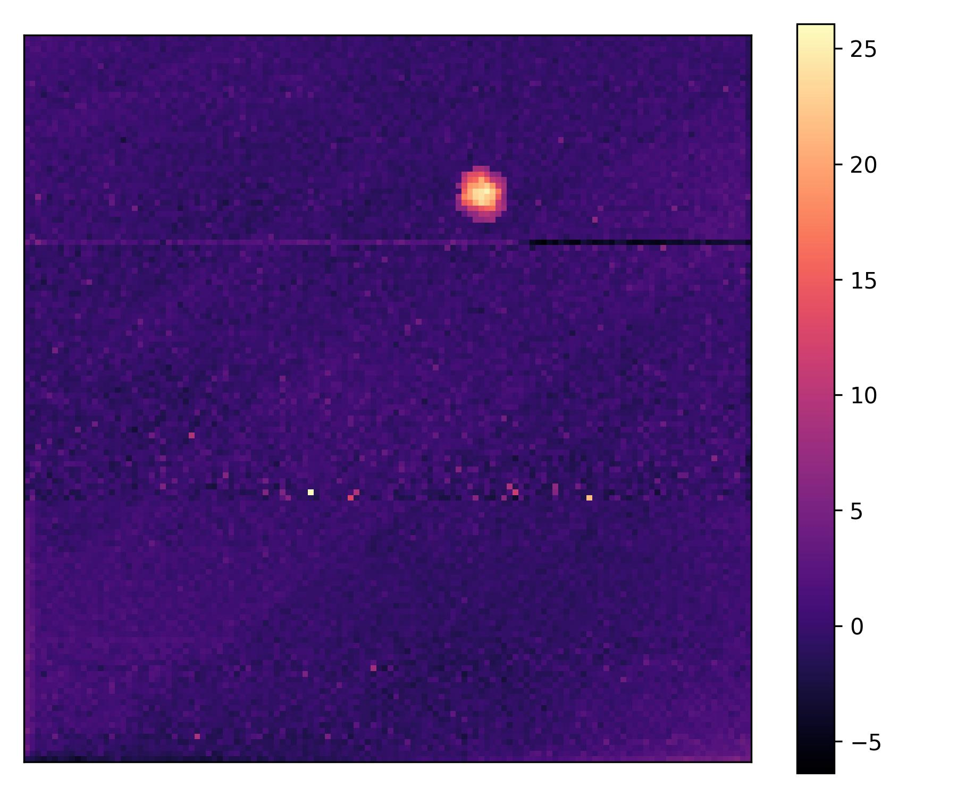
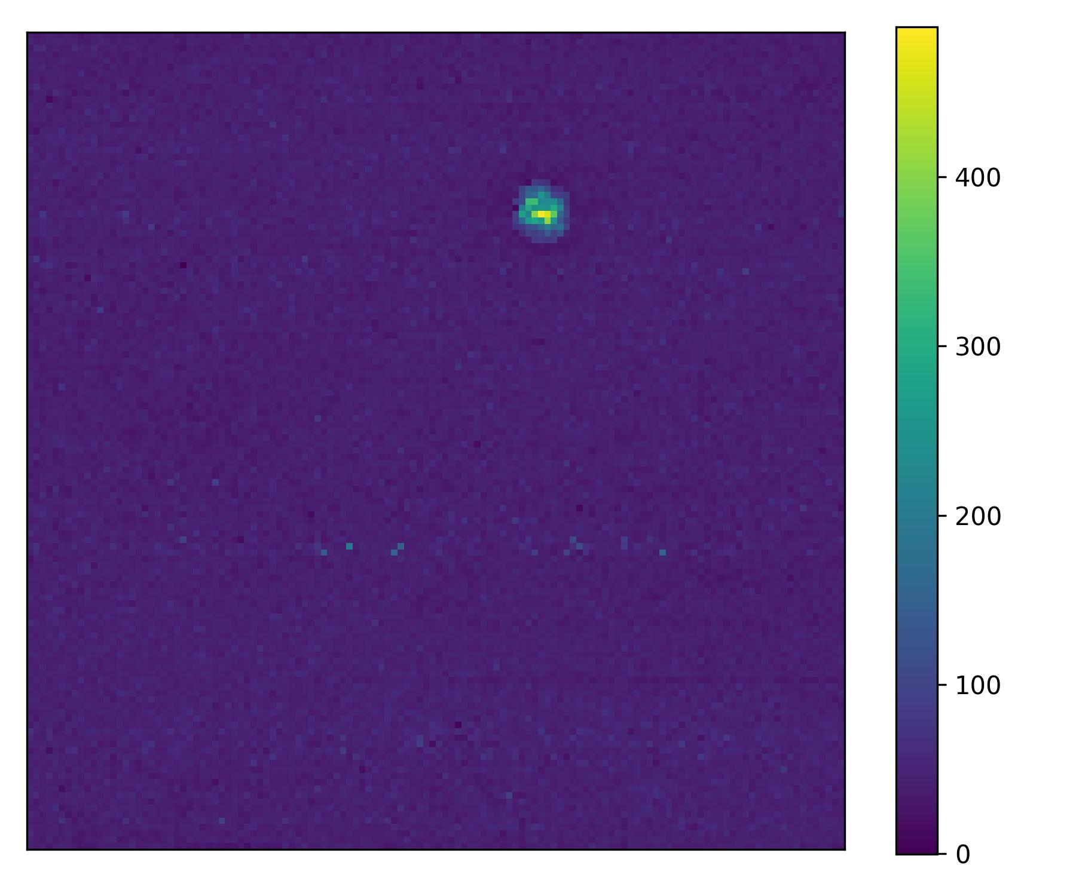

Slide 11
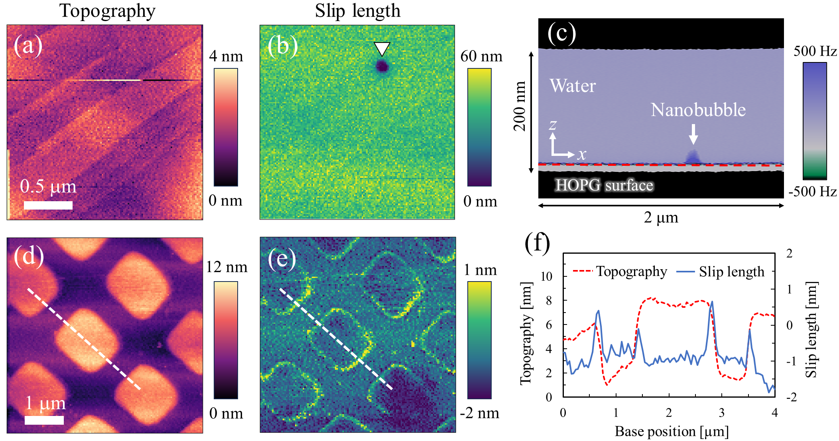

Slide 12
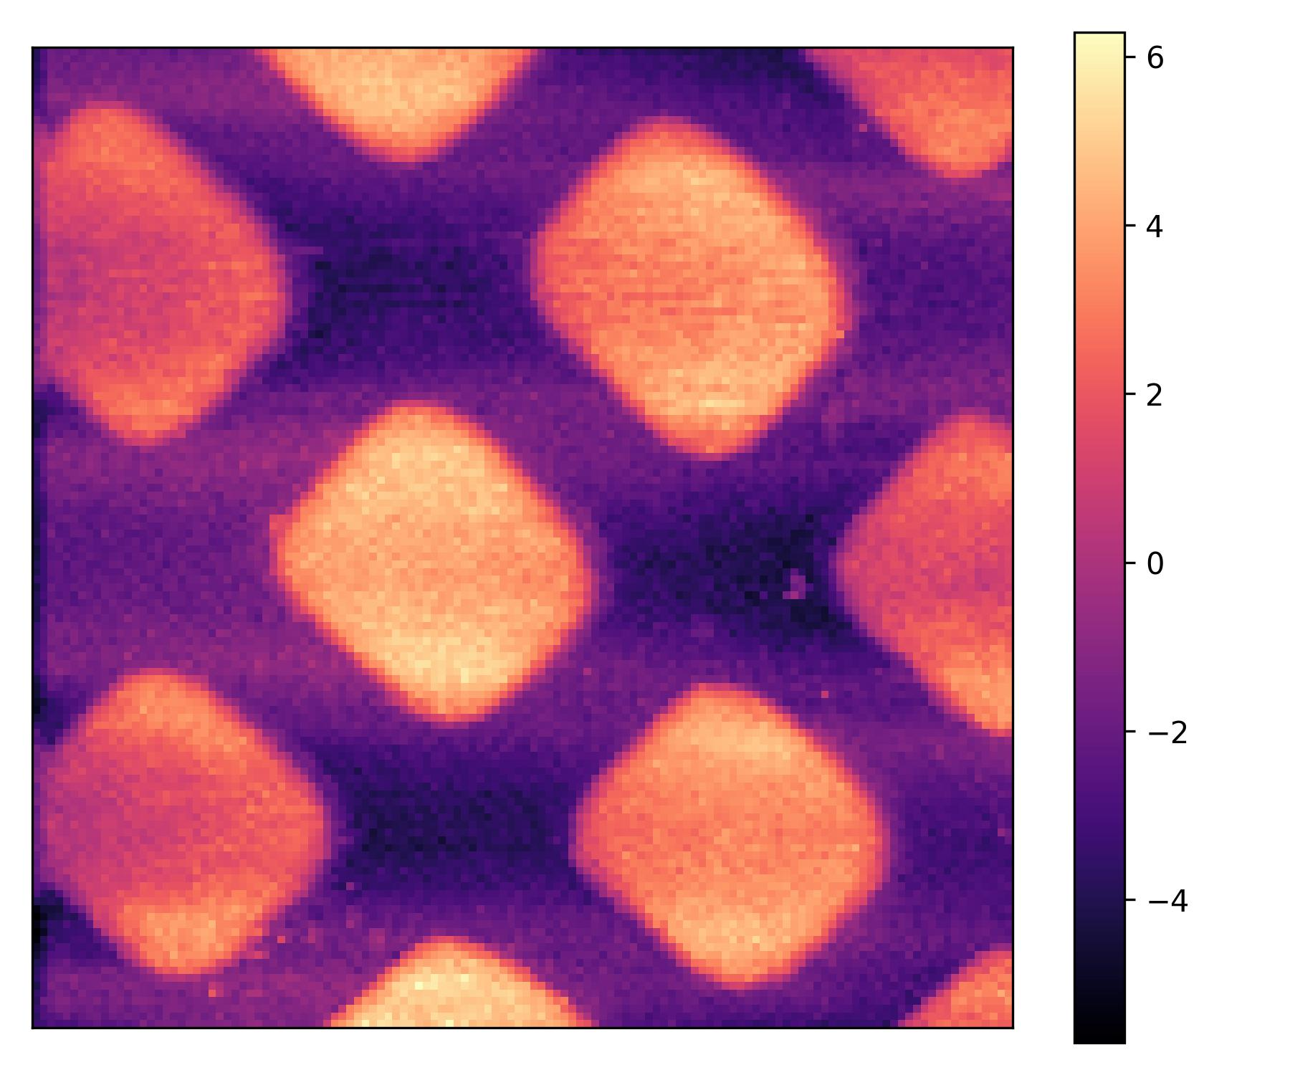
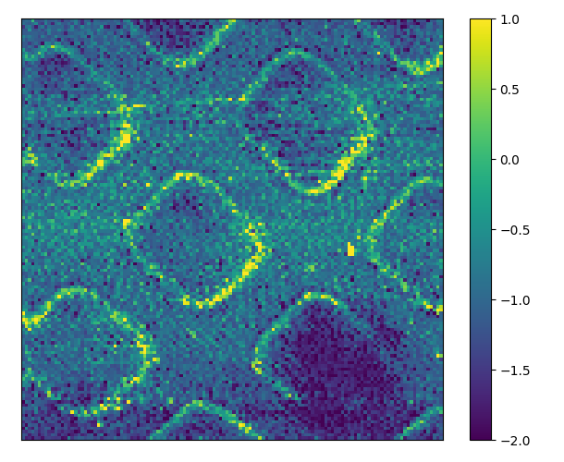
Topography
Slip length
(a)
(b)
(c)
10 nm
200 nm
500 Hz
Water
200 nm
Nanobubble
z
x
0.5 μm
-500 Hz
-5 nm
0 nm
HOPG surface
2 μm
(d)
(e)
(f)
12 nm
1 nm
Topography
Slip length
Topography [nm]
Slip length [nm]
1 μm
0 nm
-2 nm
Base position [µm]

Slide 13
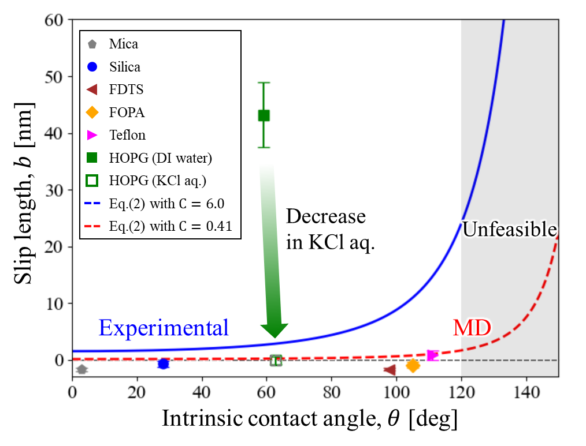

Slide 14
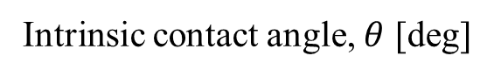
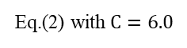
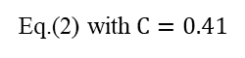
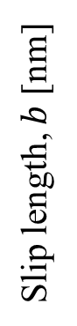
Mica
Silica
FDTS
FOPA
Teflon
HOPG (DI water)
Slip length, $b$ [nm]
HOPG (KCl aq.)
Eq.(2) with $C=6.0$
Decrease
in KCl aq.
Eq.(2) with $C=0.41$
Unfeasible
Experimental
MD
Intrinsic contact angle, $θ$ [deg]

Slide 15
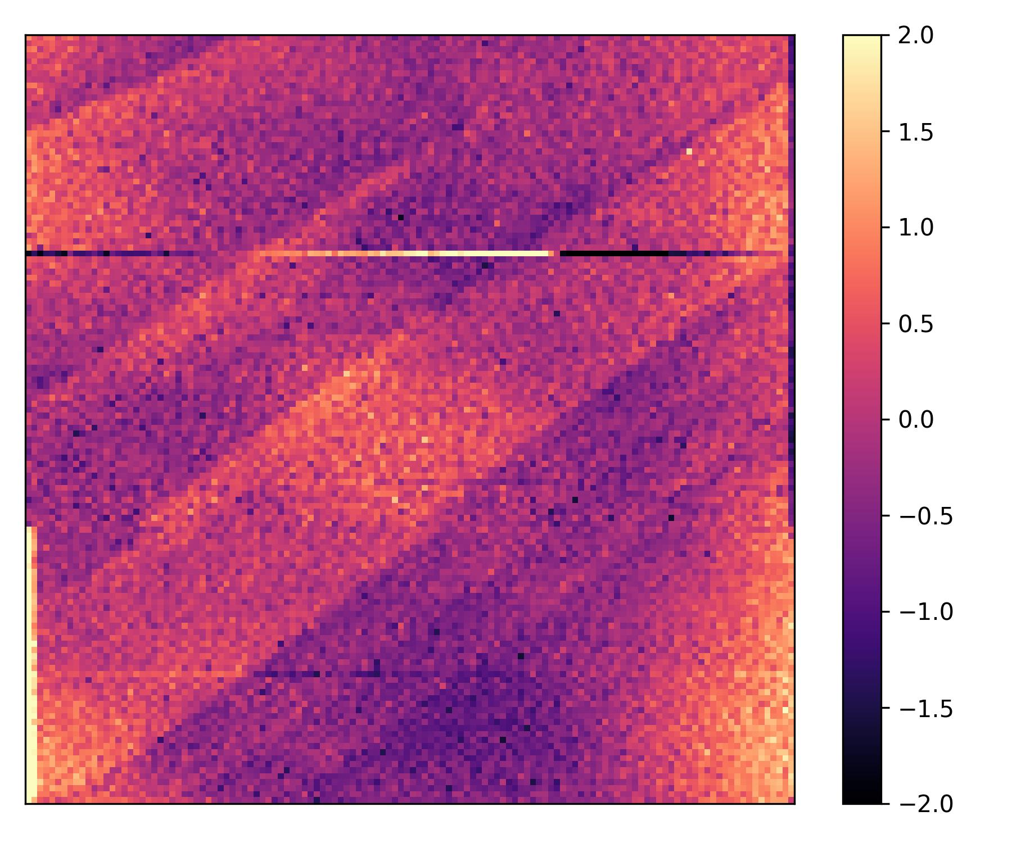
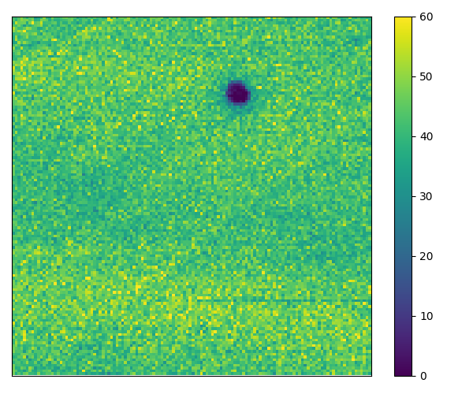
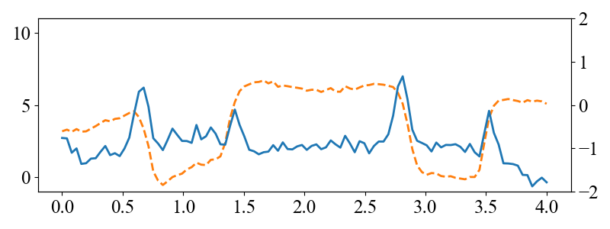
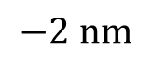

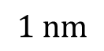
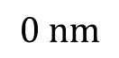
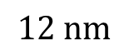
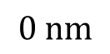

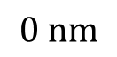
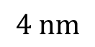

(a)
(b)
$$4 nm$$
$$60 nm$$
$$0.5 μm$$
$$0 nm$$
$$0 nm$$
(c)
(d)
$$12 nm$$
$$1 nm$$
$$2 μm$$
$$0 nm$$
$$−2 nm$$
(e)
Topography
Slip length
Topography [nm]
Slip length [nm]
Base position [µm]

Slide 16

Mica
Silica
FDTS
FOPA
Teflon
HOPG (DI water)
Slip length, $b$ [nm]
HOPG (KCl aq.)
Eq.(2) with $C=6.0$
Eq.(2) with $C=0.41$
Decrease
in KCl aq.
Unfeasible
Experimental
MD
Intrinsic contact angle, $θ$ [deg]

Slide 17




Measurement
No-slip
Fitting
Damping $γ_{total}$ [µNs/m]
Tip-sample Distance $h$ [nm]

Slide 18





$$z$$
$$+500 Hz$$
$$x$$
Nanobubble
Water
200 nm
HOPG surface
$$− 500 Hz$$
2 μm

Slide 19
































$$5 μm$$
$$2 μm$$
$$5 μm$$
$$5 μm$$
(a)
(b)
(c)
(d)
$$3 nm$$
$$3 nm$$
$$14 nm$$
$$6 nm$$
$$2 μm$$
$$0 nm$$
$$2 μm$$
$$0 nm$$
$$2 μm$$
$$0 nm$$
$$0.5 μm$$
$$0 nm$$
(e)
(f)
(g)
(h)
$$1 nm$$
$$0 nm$$
$$7 nm$$
$$2 nm$$
$$−3 nm$$
$$−3 nm$$
$$−2 nm$$
$$−3 nm$$

Slide 20


Slide 21






Slide 22







(a)
(b)
(d)
$A\left(h\right)$
$$h$$
100
Sample
Approach
1 μNs/m
30 μm
80
Damping
40
Measurement
No-slip
Fitting
20
$$z [nm]$$
Damping, $γ_{total}$ [µNs/m]
(c)
0
5
292 nm
0 μNs/m
4
5
Topography
3
4
2
$$y [μm]$$
500 nm
3
2
1
Tip-sample distance, $h$ [nm]
$$x [μm]$$
1
0
0

Slide 23






(d)
(a)
(c)
Measurement
No-slip
Fitting
1 μNs/m
100
30 μm
80
Graphite, DI water
$b_{s}$ = 43.2 nm
Damping
40
20
Damping, $γ_{total}$ [µNs/m]
$$z [nm]$$
(b)
0
Approach
5
292 nm
4
0 μNs/m
5
Topography
3
4
2
$$y [μm]$$
500 nm
3
Tip-sample distance, $h$ [nm]
2
1
$$x [μm]$$
1
0
0

Slide 24


(a)
(b)
(d)
$A\left(h\right)$
$$h$$
100
Sample
Approach
1 μNs/m
30 μm
80
Damping
40
Measurement
No-slip
Fitting
20
$$z [nm]$$
Damping, $γ_{total}$ [µNs/m]
(c)
0
5
292 nm
0 μNs/m
4
5
Topography
3
4
2
$$y [μm]$$
500 nm
3
Tip-sample distance, $h$ [nm]
2
1
$$x [μm]$$
1
0
0

